Slide 1
Name: Swapnil Ghosh
Group: A2
Roll: 001911001067
TASK 15

Slide 2
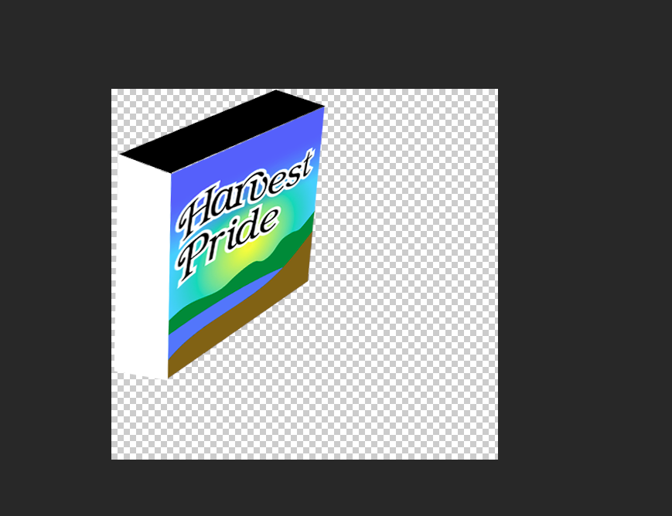
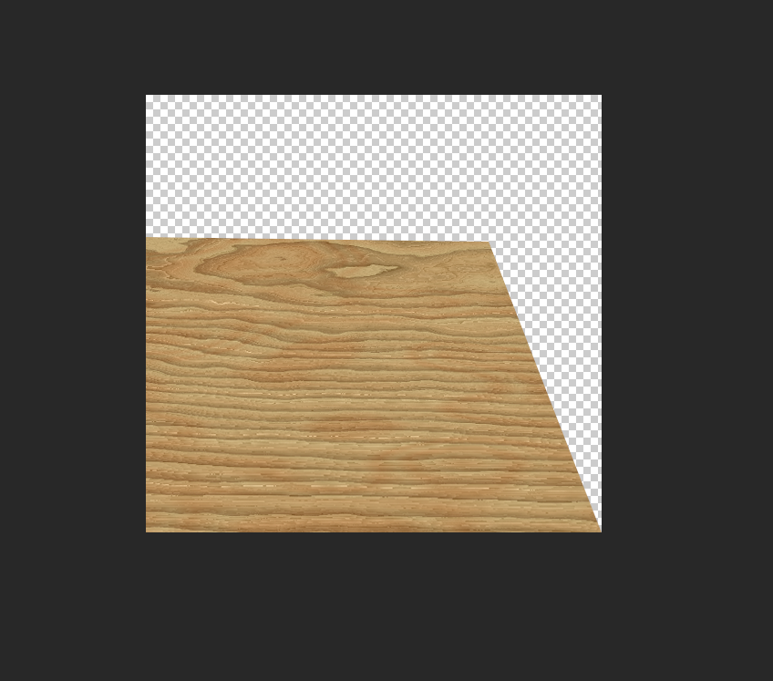
Step-1) Opened the file PRIDE.TIF in Photoshop.
Step-2) I used Distortion Tool to align and distort the image.(My PS dosen’t support 3D Transform)
Step-3) Added the dimension to the box using selection tool and fill option.
Step-4) Opened the file OAK.TIF in Photoshop.
Step-5) I used Distortion Tool to align and distort the oak flooring.

Slide 3

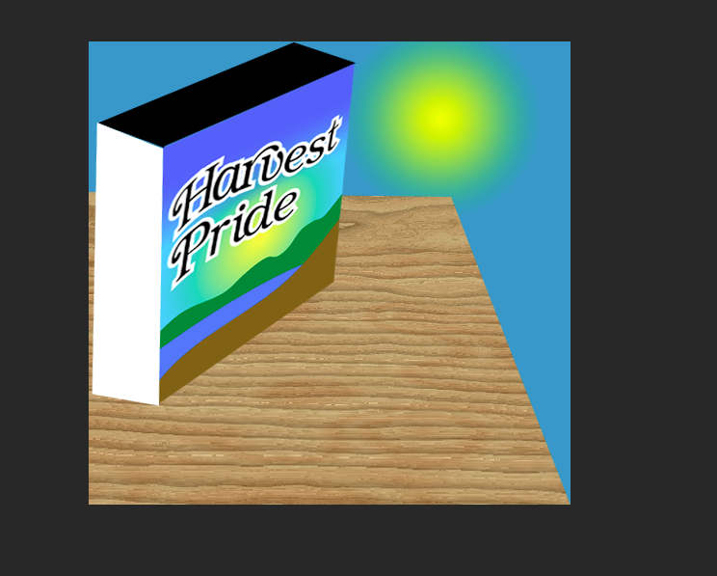
Step-6) Created a new layer, name as sky and drag below the oak layer.
Step-7) Set blue as the background color and fill layer sky with background color and set yellow as foreground color.
Step-8) Choose the Foreground to Transparent gradient and Radial Gradient mode and draw the Morning Sun.
Final Image

